Slide 1
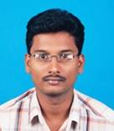
About Me
DOB: May 1st 1982.
Place Of Birth: Madurai

Slide 2
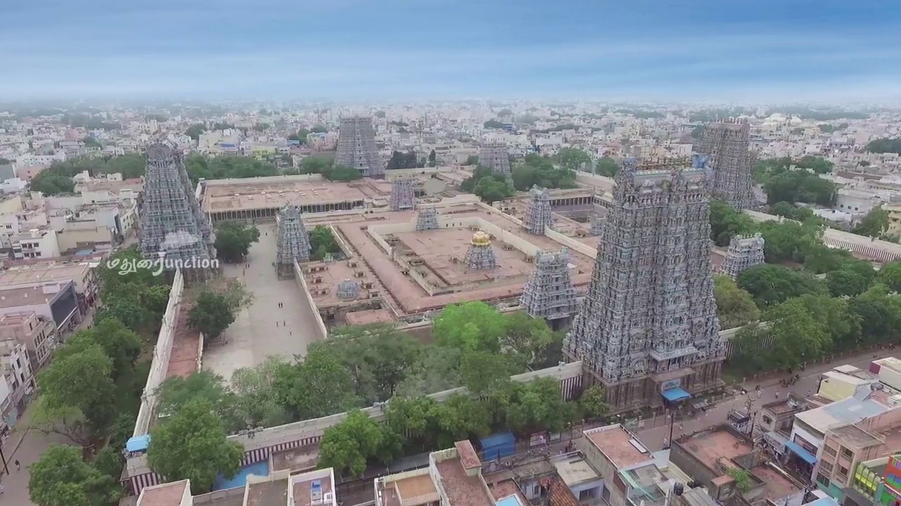
Place of Birth
Meenakshi Amman Temple, also known as Minakshi-Sundareshwara Temple, is one of the oldest and most important temples in India. Located in the city of Madurai, the temple has a great mythological and historical significance
Madurai is a major city in the Indian state of Tamil Nadu. It is the cultural capital of Tamil Nadu and the administrative headquarters of Madurai District, the third largest city in Tamil Nadu and 44th most populated city in India. Located on the banks of River Vaigai:

Slide 3
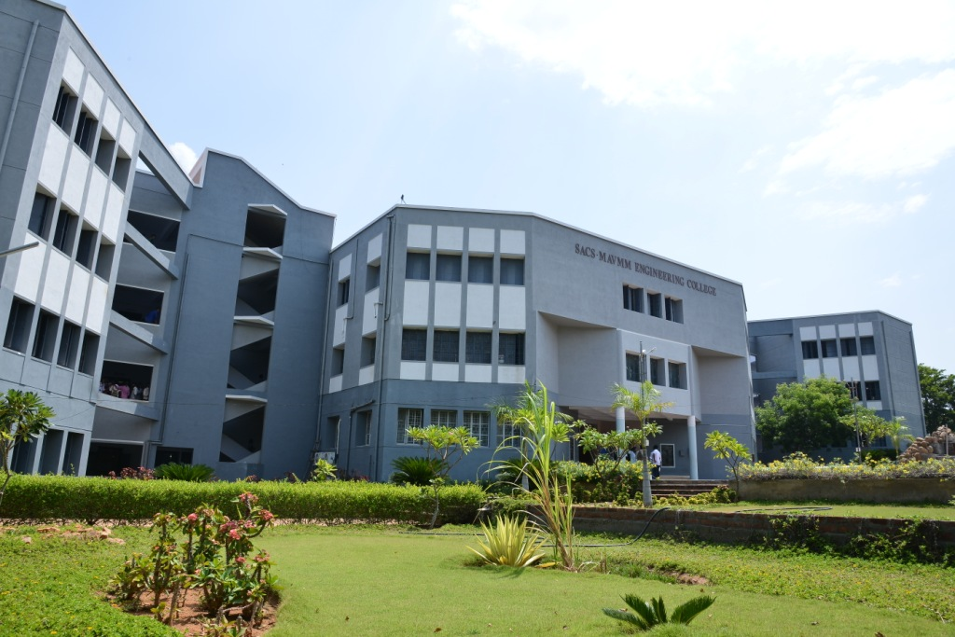
College
Significant event description
SACS MAVMM Engineering College is one of the reputed Engineering institutions in Madurai Tamilnadu. This College was established in the year 1998. SACS MAVMM Engineering College currently offers following Four Year BE Degree Courses.
Myself Completed B.E(Bachelor Of Engineering) in the Year 2004

Slide 4
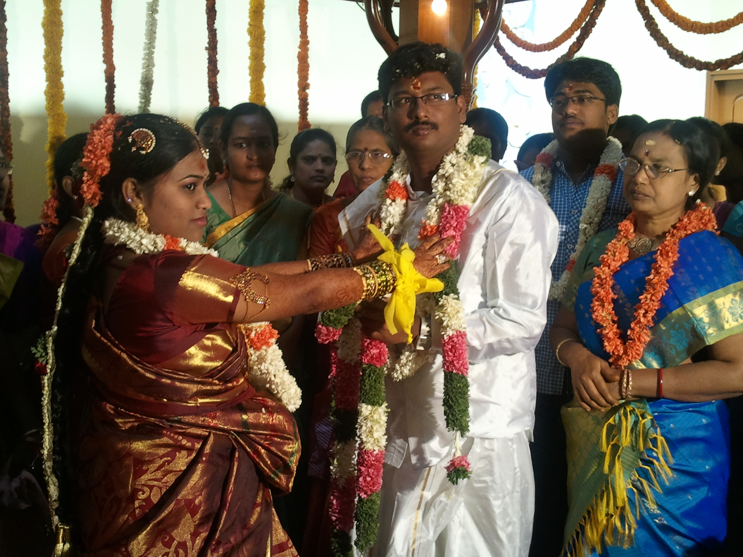
Marriage
Date of Marriage: Feb 4 2011
Venue of Marriage :Bangalore(Karnataka)

Slide 5
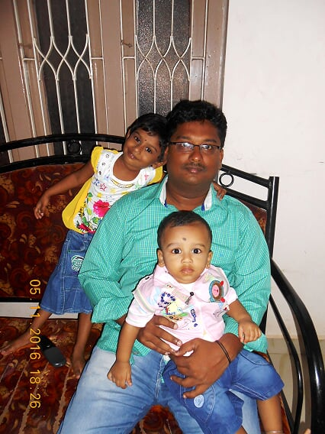
Kids
Varsha and Vishnu
Varsha (now 6 Years old)
And Vishnu (now 4 years Old)

Slide 6
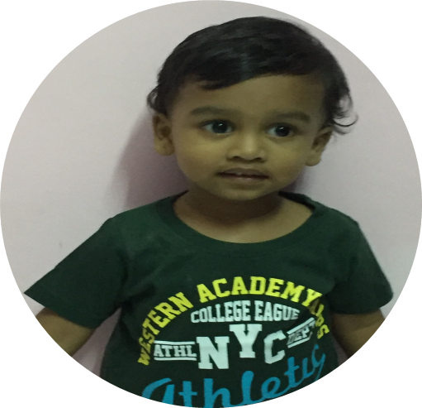
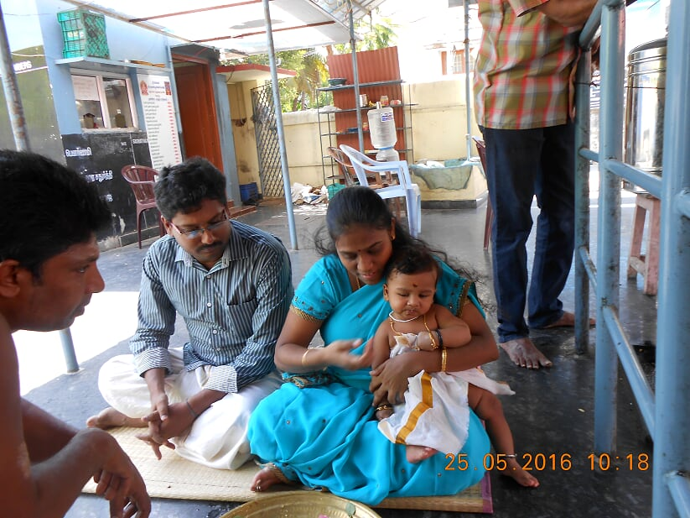
Kids
Vishnu Feeding Ceremony

Slide 7
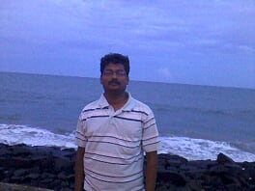
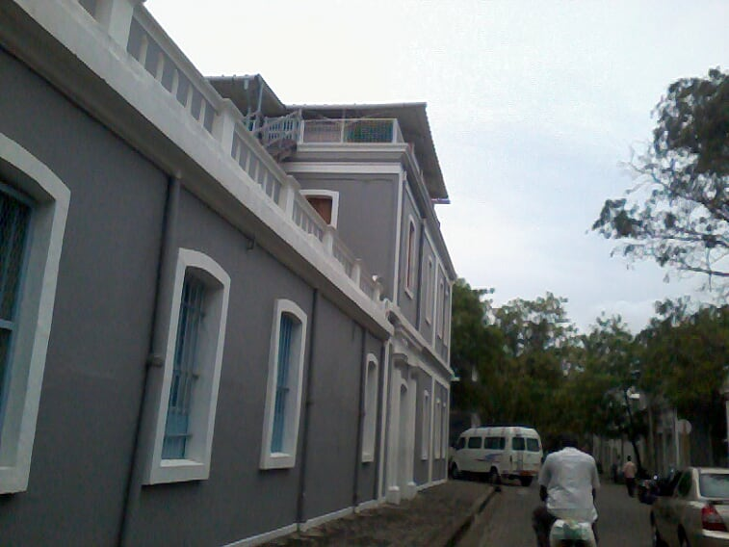
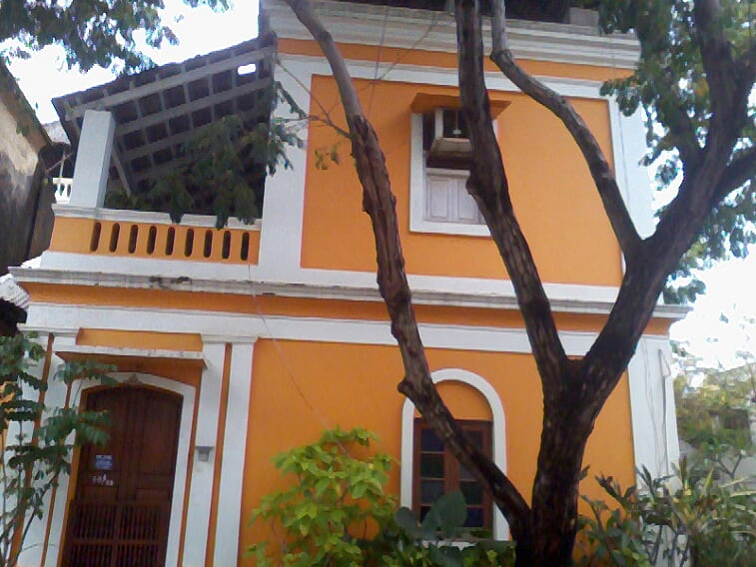
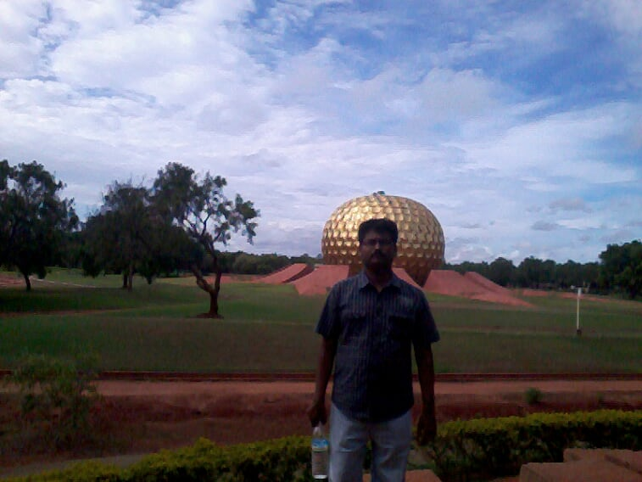
Trips(Pondicherry)
Pondicherry
Though very small, Pondicherry was the largest French colony in India. The city has a long and interesting history of trade and war. There is a strong French influence in the city, especially in the old quarters, with Rues and Boulevards lined with Mediterranean style houses and bakeries, although the city remains very much Indian. French is still understood, and the whole city makes for rather pleasant mix of East and West. It is also known as The French Riviera of the East (La Côte d'Azur de l'Est). If you've spent some time in Tamil Nadu and approached Pondicherry by land, you'll very likely experience mild culture shock on discovering French architecture and restaurants serving steak and good wine. Pondicherry is very much a city with a dual personality: crossing from East to West of the central canal reveals two cities with very different characters.

Slide 8
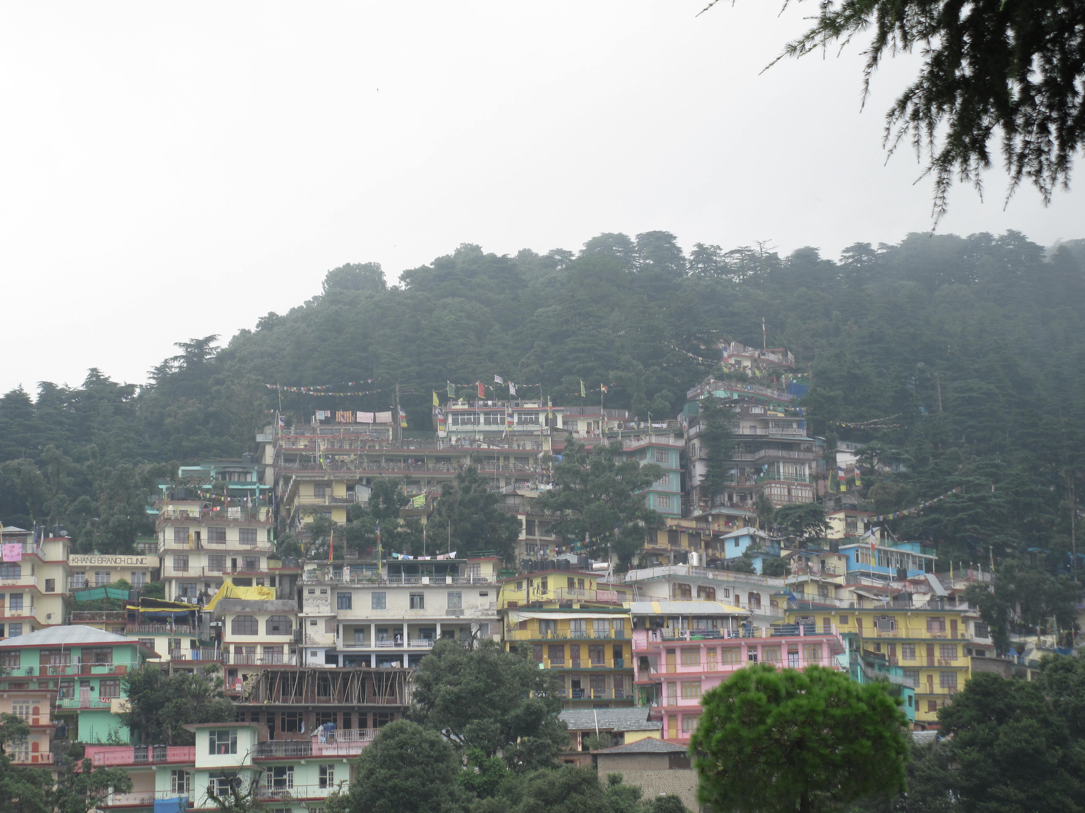
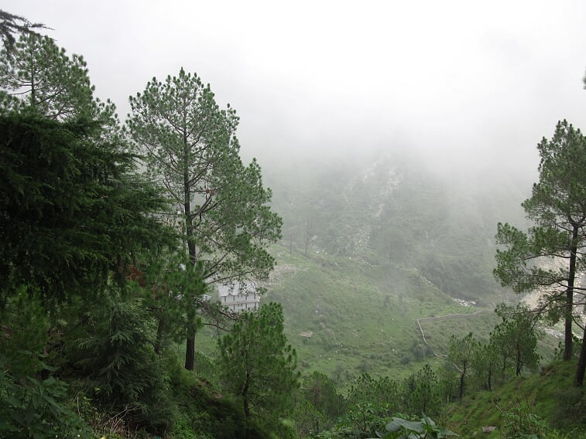
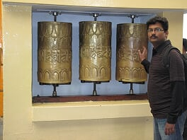
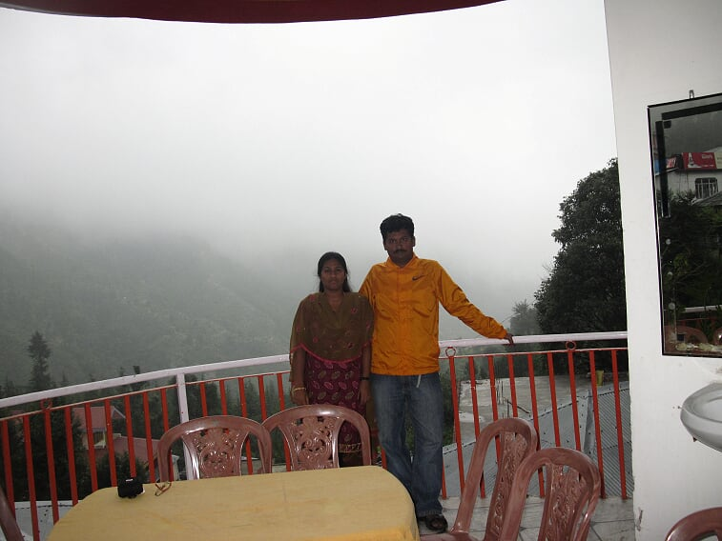
Trips(Dharamsala)
Dharamshala is a municipal corporation city in the upper reaches of the Kangra Valley and is surrounded by dense coniferous forest consisting mainly of stately Deodar cedar trees. This place is also famous for its Himachal Pradesh Cricket Association Stadium (2003), which offers opportunities to the youth of state to prepare for their future in the game. The village of McLeod Ganj, lying in the upper reaches, is known worldwide for the presence of the Dalai Lama. On 29 April 1959, the 14th Dalai Lama (Tenzin Gyatso) established the Tibetan exile administration in the north Indian hill station of Mussoorie.[6] In May 1960, the Central Tibetan Administration (CTA) was moved to Dharamshala, making it the centre of the Tibetan exile world in India. Following the 1959 Tibetan uprising there was an influx of Tibetan refugees who followed the 14th Dalai Lama. His presence and the Tibetan population have made Dharamshala a destination for Indian and foreign tourists, including students studying Tibet. Dharamshala also has several tea gardens and its tea, known as Dharamsala or Kangra tea, is very popular across India and the rest of the

Slide 9
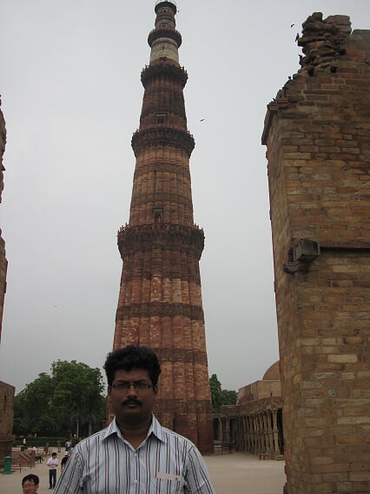
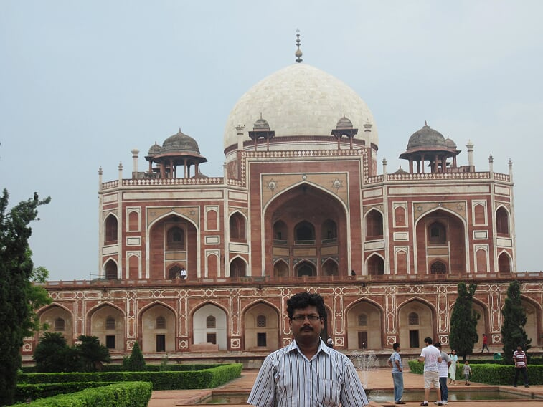
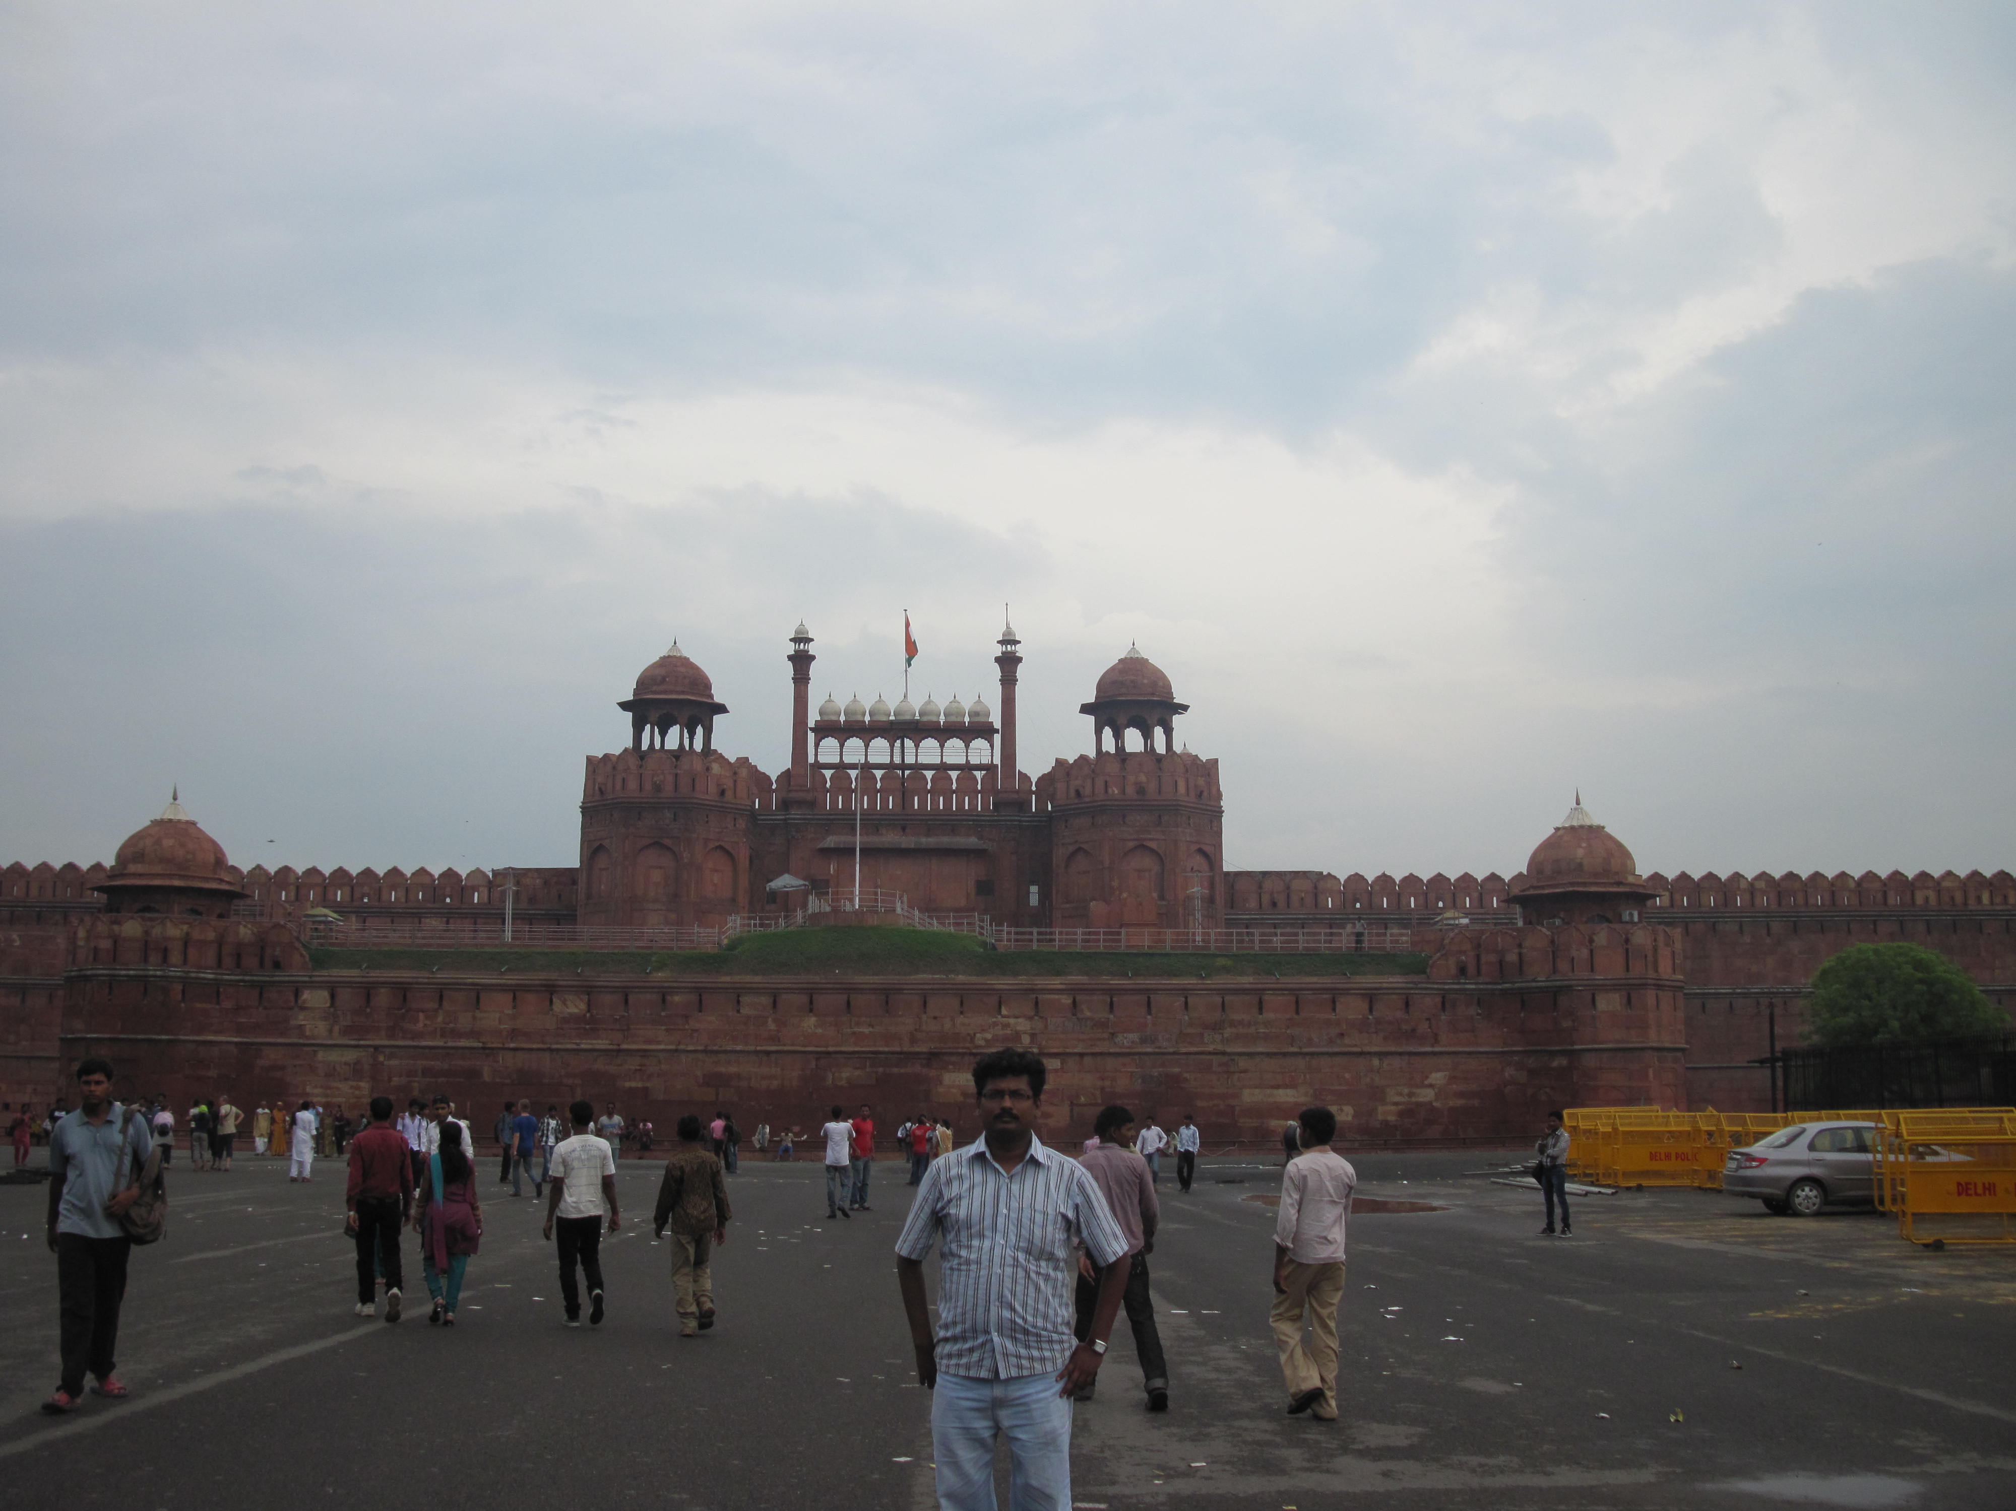
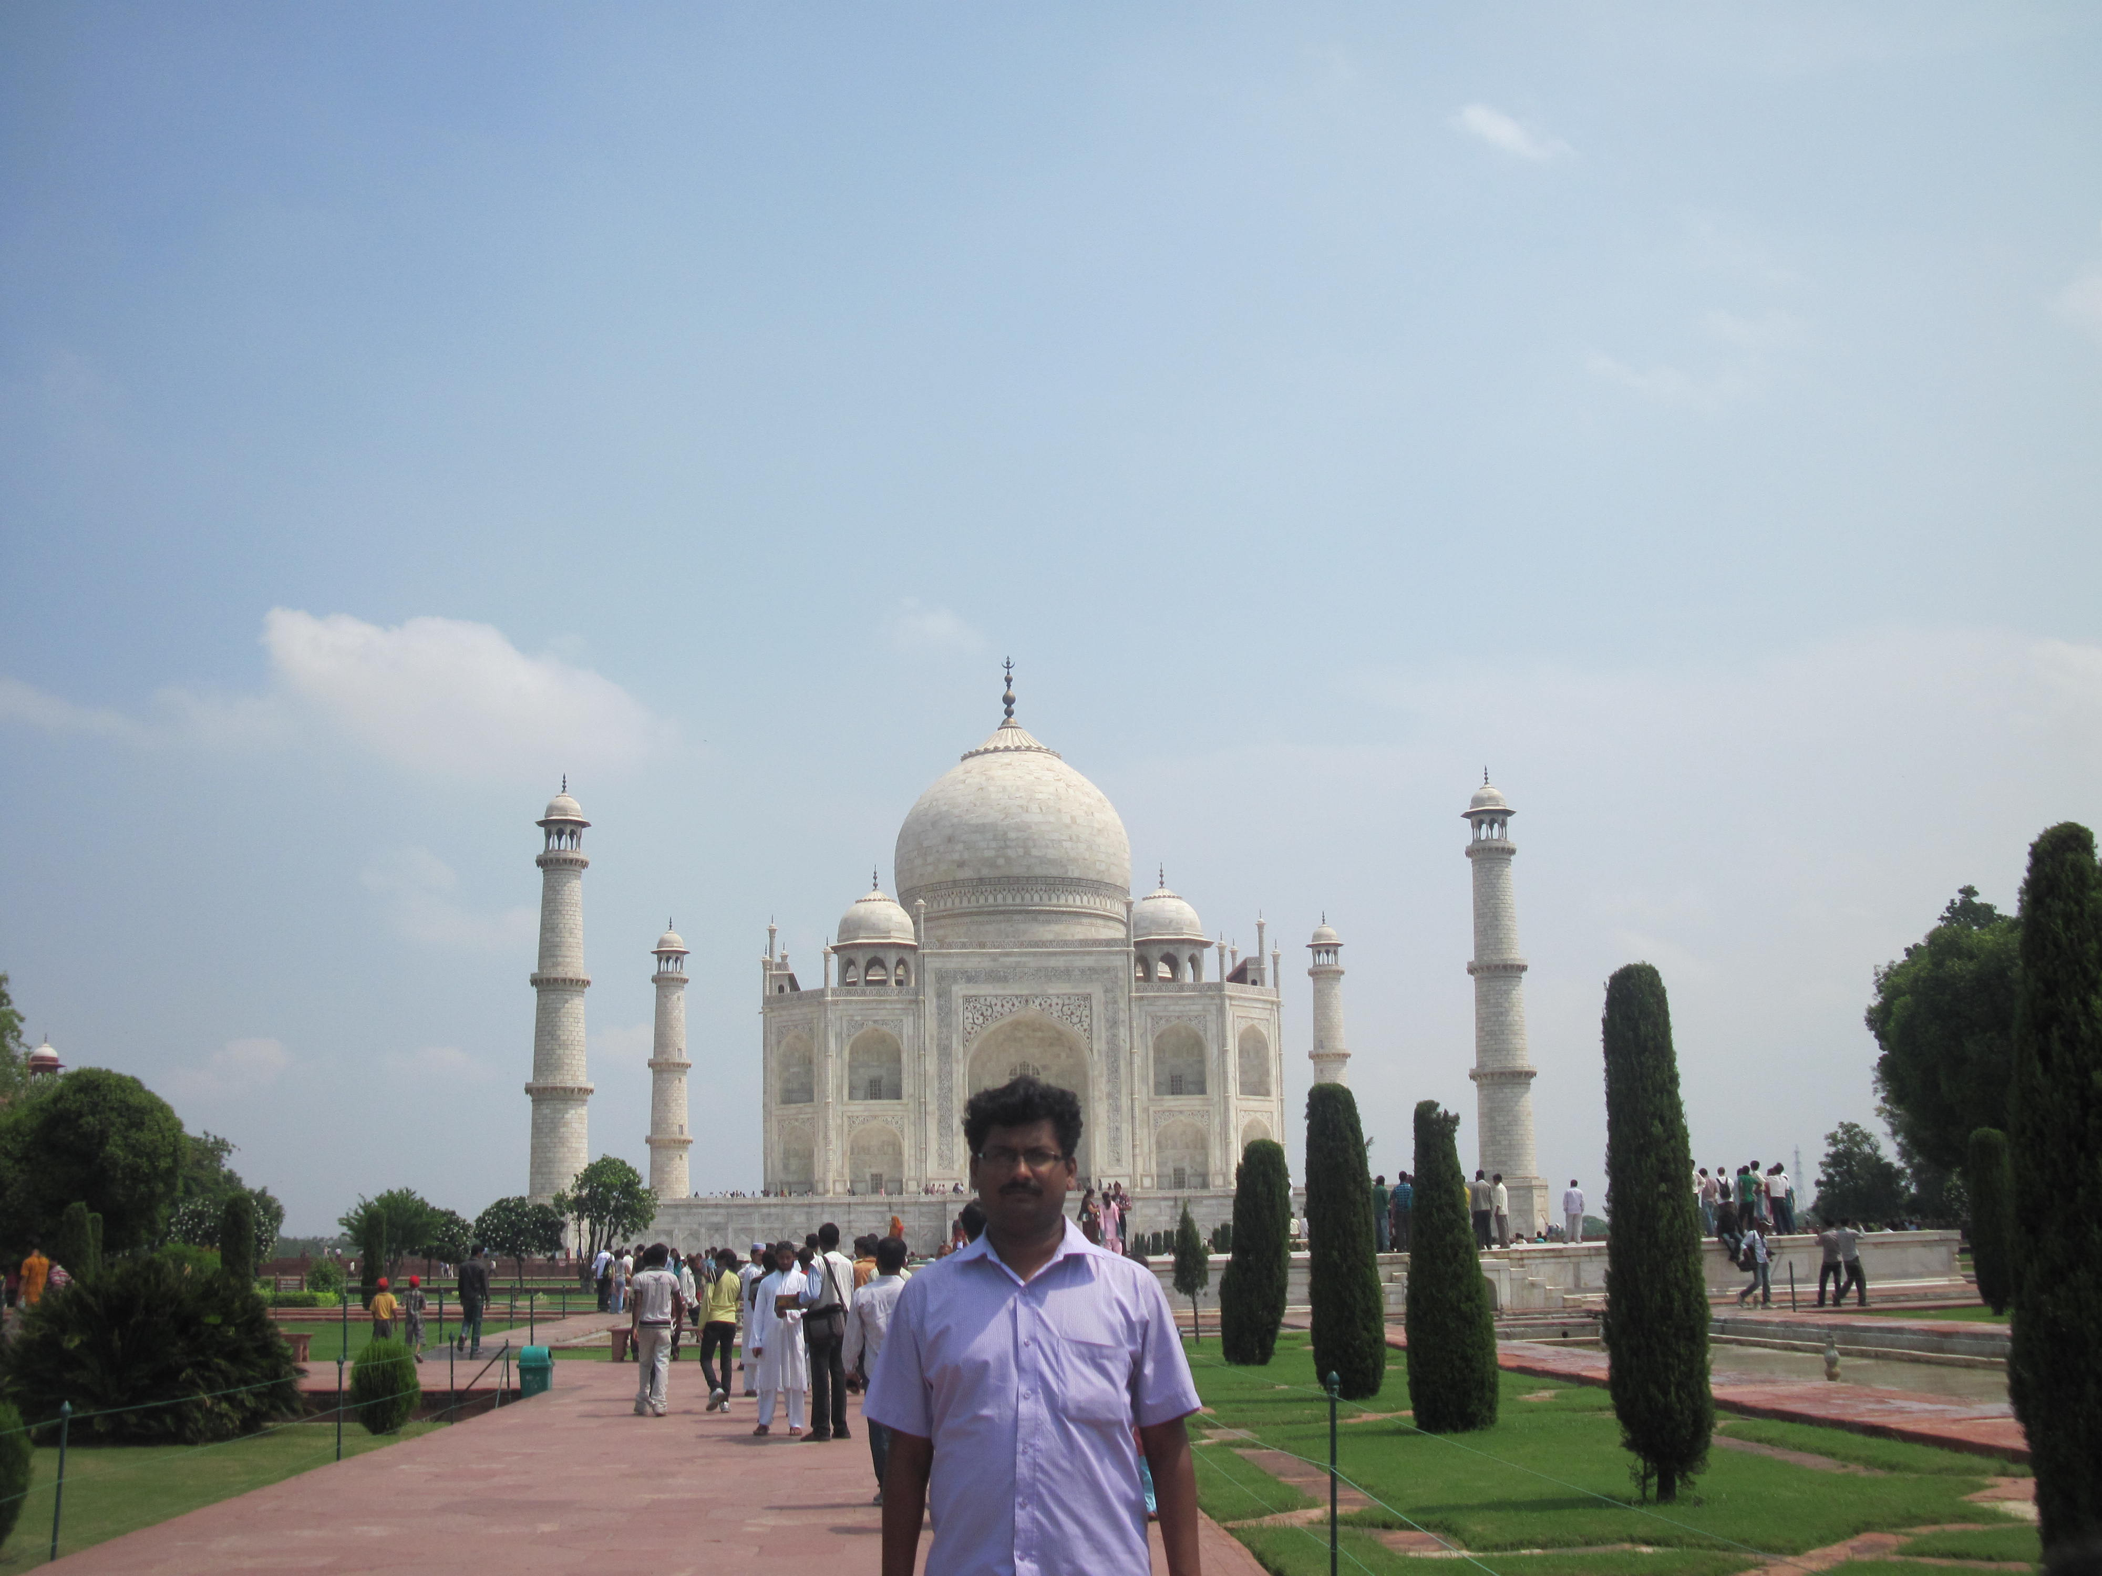
Trips(Delhi)
Delhi officially the National Capital Territory of Delhi (NCT), is a city and a union territory of India containing New Delhi, the capital of India.

